Slide 1
Contactless Loyalty
Shouyi Cui
A Final Year Project guide

Slide 2
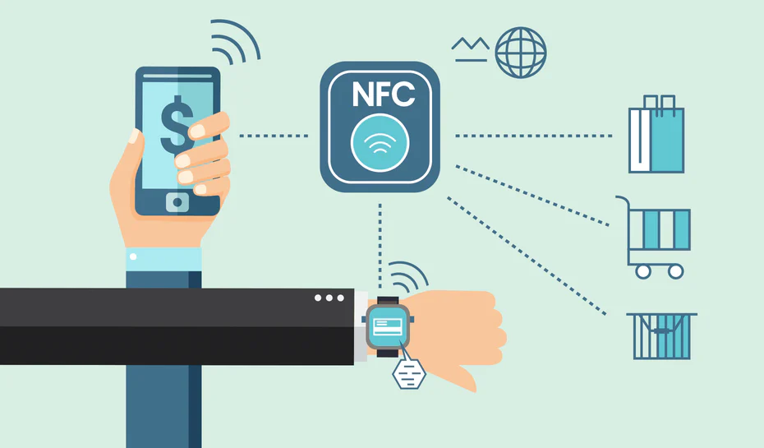
1. Why NFC Technology?
Find something you love to work on.
Notes:
The best approach for the FYP is to find something that you would love to study outside of the modules taught in the course. Because when it gets hard to continue, you still need the passion to work on it.
Something that have always fascinated me was the NFC technology and because I was ignorant about it, this was the best opportunity to me to learn more about this.
What intrigued me to this topic was: “How does it actually work?” It’s so simple to use and how hard is it to develop something that uses it?
I felt it was like working with Black Magic.

Slide 3
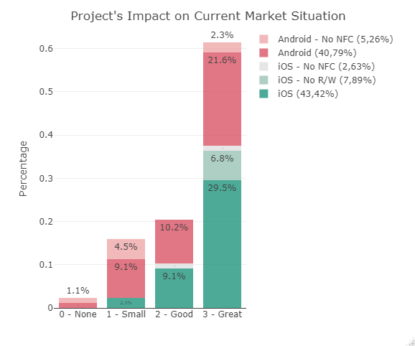
2. Would people use it?
Would you use it yourself?
Notes:
Whatever is your software or work going to bring in the world, think about something that people can use. If as soon as you start talking you see at least one person getting immediately interested in the topic, that’s good news. You’re on the right track.
To understand and support your idea of development, you should make a survey or something that proves your ideas. In this way from the answer/feedback they can also give you some guidance on what they would expect from the software.
I have made a quick survey that has told me that people would have loved to use something like my solution.

Slide 4
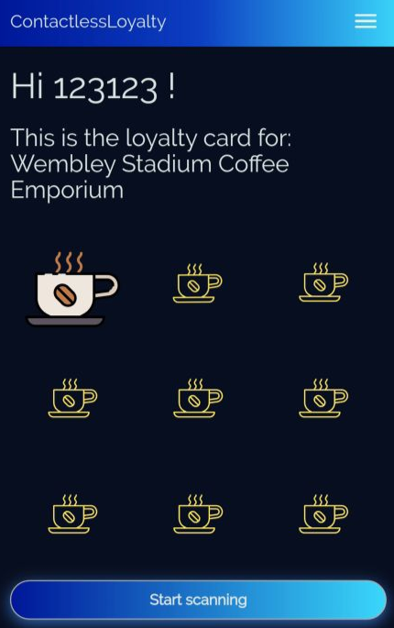
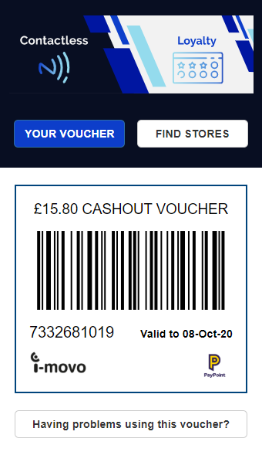
What is my work about?
Loyalty Scheme
Digital Vouchers
Easy Interaction
Notes:
My idea was related to find a purpose where I could fit the NFC to something that QR code was already using. Initially I was thinking to develop something similar to Google Pay and Apple Pay, basically a digital wallet where people could hold many retailers loyalty cards. But instead of scanning the barcode from the phone, they would just tap on the till in the same way they were paying with the NFC.
Simple use case is:
I go to a coffee shop and buy an espresso
Because I have satisfied the loyalty scheme requirements, I am eligible for one point by scanning my phone to a NFC tag.
The cashier hands me the tag where I can scan
I scan it and the point is added in my user records
I have collected enough points for a free coffee and I click on the receive voucher button
I receive the voucher to use in one month time by SMS

Slide 5
What is new?
Web Application with NFC
Experimental feature developed by Google Chrome on trial during January to July 2020
Collaboration on GitHub with the creators
Using Microsoft Azure

Slide 6
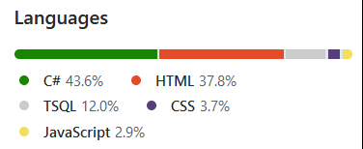
How did I create it?
Implementing
Testing
Fixing
Documenting

